Slide 1
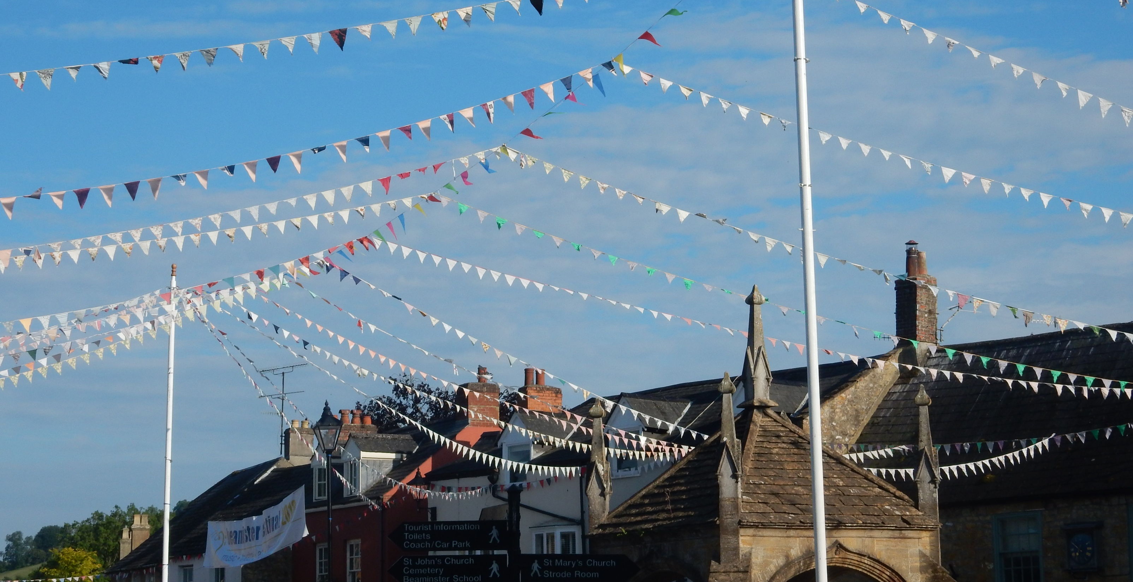
Beaminster Neighbourhood Plan
Survey Results

Slide 2
Beaminster Neighbourhood Plan
Survey results - summary
A survey of Beaminster residents was carried out between December 2024 and March 2025 about the Beaminster Neighbourhood Plan.
The responses will be used to guide the development of the plan. They will be summarised and further consulted upon before the draft plan is produced.
Responses from residents aged 18 – 50 were limited and that group will be consulted further.
96.12% said Beaminster would benefit from a neighbourhood plan

Slide 3
Respondents profile
19.33% of respondents did not live in Beaminster (this could mean they live within the parish).
14.67% did not have a DT8 postcode but work or attend school here.
44.79% of respondents have lived in Beaminster for over 10 years.
Most of the respondents - 65.85% - are over the age of 51.
15.69% were under the age of 18.
14.46% of the respondents were from the 31 – 50 age group.
Only 4% were from the 18 – 30 age group

Slide 4
Respondents profile
Of the 294 that replied to the question about home ownership:
80% are homeowners – possibly reflective of the dominant age group that responded
20% are in rented accommodation
We know that 51 of the 325 respondents are under the age of 18 – the majority of respondents who skipped this question were living with parents.
Further consultation will be carried out to gain views from the under-represented groups.

Slide 5
Transport and travel
Respondents were asked if they used public transport
34.67% answered yes
65.33% answered no
When asked if they used the community bus
16.72% answered yes
83.28% answered no
The role of the community bus has changed since this survey

Slide 6
Transport and travel
When asked about their usual mode of transport people answered:
73.83% motoring
14.02% walking
11.21% public transport
0.93% cycling
When asked to rate the transport infrastructure
44.30% were neutral
15.19% rated it good
40.50% rated it bad

Slide 7
Transport and travel
37.66% of respondents were dissatisfied with the public transport
46.20% were neutral.
People wanted more buses, running more frequently - where and when people want them - services that do run often finish too early.
Timetables do not reflect the needs of workers, shoppers, people who would like to go out in the evenings – anyone that cannot drive. No Sunday services.
Services should link with other transport: trains, buses to other locations – although direct bus routes to main towns preferred.
There are no feeder routes from outlying communities to these bus routes. A service to The Green was requested

Slide 8
Transport and travel
Would smaller buses help increase the frequency of buses
Electronic screens at main stops, such as The Red Lion would help when services are unexpectedly cancelled.
Someone suggested a one-way system around the square
EV chargers
.

Slide 9
Traffic management and parking
Suggestions for improvement included:
Traffic calming measures and extended speed restrictions that are enforced.
Enforcement of parking restrictions, residents parking in town centre.
Less parking in the Square and more open space for socialising ad pedestrians, a market or other events.
A pedestrian crossing at the square to the Greyhound

Slide 10
Pedestrians, footpaths
Suggestions for improvement included:
There are many comments regarding the lack on maintenance to Highways and Footpaths and general cleaning of the same.
There is concern for the safety of pedestrians in locations where there are no pavements and where pavements are too narrow.
More pedestrian crossings – St Marys (currently being reviewed) and at the square

Slide 11
Walking and cycling network - active travel
Beaminster has a good network of footpaths which with small improvements and ‘joining up’ could be a great asset to the town. People mentioned wanting:
Safer cycling and walking routes, including improvements eg. the surface of Shorts Lane would provide a safer pedestrian/cycling route than Hogshill Street
Access into and around shops is difficult for people with mobility issues.
Improvements to footpaths generally – poorly maintained in winter.
Pavements where they currently do not exist or wider pavements to make walking safer

Slide 12
Green space
81% respondents were satisfied or very satisfied with Beaminster’s parks and green spaces. 12.5% were neutral.
This may reflect that we exist within an area of outstanding natural beauty.
The town has a large playing field behind Hogshill Street, so very central. However comments from other parts of the survey suggest that more spaces to sit and socialise would be desirable.
The green infrastructure section will consider how to preserve and enhance our green spaces.

Slide 13
Environmental issues
Asked how concerned they were about environmental issues:
57.46% were concerned or very concerned
24.53% were neutral
18.02% were unconcerned
There was a good response when asked what actions they would support to make Beaminster more environmentally sustainable - overwhelmingly residents wanted better public transport, after this renewable energy options – especially in housing, and recycling, also cycling and support for electric vehicles.
Other ideas and actions are listed on the following pages.

Slide 14
Environmental issues - actions
Better public transport
Smaller buses as many seem run half-empty.
Are bus companies considering electric or hydrogen powered buses.
Renewable energy initiatives - incorporated in all new housing.
Make funding available for retro-fitting to all types of property.
Using the water sources - is there a way to harness power from these.
Recycling points around the town to supplement fortnightly collection. Mini recycling depot or a communal skip (to avoid travel to Bridport).
More litter bins (note BTC pay Dorset Council per bin for collection).

Slide 15
Environmental issues – actions
Cycling as an alternative to driving - risks of cycling on narrow Dorset roads needs to be overcome by dedicated cycle paths.
More and faster EV chargers, alternative solutions for to on-street charging. Installations at places of work.
Traffic calming, speed restrictions, fewer HGVs – all reduces pollution.
Overflows into the Brit together with run off from fields need to be addressed. Storage and reuse of rainwater to be encouraged.
Air quality caused by traffic, bonfires and wood burning stoves raised as a concern.
A reduction in the time street lights remain lit (some did not want this due to safety concerns).

Slide 16
Housing development
88.65% thought it important that development meets local needs.
82.5% wanted new developments to include affordable and shared ownership options.
86.65% thought that new housing developments should integrate well with existing.
91.02% wanted developments to include green space
82.92% considered it important that housing design was sustainable.

Slide 17
Housing development
Respondents answered the question about the type of dwellings they would like to see as follows:
Family homes 74%
Smaller homes 58%
Bungalows 37%
Apartments 26%
60% of respondents wanted to see dwellings offering supported living or sheltered housing.
20% of respondents were interested in Live/Work opportunities

Slide 18
Housing development
A range of other dwelling types were suggested including accessible homes, especially for older residents, small affordable starter homes, and varieties of tenure including long term rental, homes for keyworkers, shared ownership and co-housing.
When answering the following related topics were raised:
Infrastructure, especially transport, sewage, flood management
Eco-friendly design and integrated renewable

Slide 19
Community facilities - Education
51.74% are satisfied with these services
44.76% are neutral on the subject
3.49% are dissatisfied with these services
Beaminster School (secondary) at 90% capacity; the demographics reflect that the Dorset catchment area has fewer families with children, now drawing from South Somerset.
Beaminster St Mary’s has grown from 85 to 140 over the last few years. Their Pupil Admission Number sets the maximum at 210 spaces.
Respondents state that nursery and childcare provision is poor, as are after school ad holiday activities.

Slide 20
Community Facilities
64.69% are satisfied with these facilities
27.81% are neutral on the subject
7.51% are dissatisfied with these facilities
More needs to be provided to keep the youth of the area interested and occupied
Facilities like the museum and library need better signposting. Those who commented on the library felt it needed more space and better facilities, easier access and longer hours.
Lots of comments about keeping the pharmacy and the post office

Slide 21
Community facilities - sporting and leisure facilities
37.93% are satisfied with these facilities
37.93% are neutral on the subject
24.14% are dissatisfied with the facilities
There are good facilities in Beaminster but it does not cater for everyone.
The loss of the swimming pool at the school is felt keenly by some who would like to see a swimming pool in the town.
Many respondents asked for a gym, outdoor gym and fitness or leisure centre.
The playground equipment caters only for younger children.

Slide 22
Community facilities - healthcare services
46.11% are satisfied with these facilities
26.17% are neutral on the subject
27.83% are dissatisfied with these facilities
When given the option to comment further, healthcare services attracted the most response. When the responses are coalesced the issues that arose stemmed from a perception that there is a lack of GPs.
People have to travel large distance to find NHS treatment (national issue).
There was concern that the pharmacy is strained both by workload and finance, and may be lost.
Others mentioned a home care for the elderly, so people did not have to move away and services those who are house bound, disabled or suffering from mental conditions are overlooked.

Slide 23
Employment, jobs, business
50.93% do not work – reflective of the age group that responded.
Of those that work – 49% - the split is 23/26% between those who work in Beaminster and those that do not.
53% of respondents were neutral about job availability.
This last may reflect the age group and employment status of the majority of respondents – further research necessary. Even so 39% thought availability was bad.
Respondents to the open questions suggested that more opportunities for employment, training and work experience would be beneficial.

Slide 24
Business and services
Most people would welcome more business into the town. This ranges from any larger manufacturers to all smaller business. In particular it indicates people want to be able to work locally and want flexible working arrangements to be able to work around child care, etc.
There was recognition that younger people need the opportunity to get into work.
Businesses offering apprenticeships, training and work experience.
Banking hub (ATM in Coop, post office has limited services.)
Child care for working families especially during non-term times

Slide 25
Business and services
Younger people do not consider they are well served by the town’s offerings
There is a repeat of previously mentioned business/services that do not fulfil a need – ie health care, fitness, no farm market, etc
Number of suggestions related to tech business.

Slide 26
Community infrastructure – shopping
Respondents said they used the shopping facilities in Beaminster:
Always 26.88%
Often 48.44%
Occasionally 23.13%
Never 1.56%
Shops in Beaminster are well used by many but for the others there are some common themes including a need for an improvement in opening hours, competitive pricing, more choice both in goods offered and shops

Slide 27
Community infrastructure – shopping
Although most feel the town is well served a number of people would like:
Clothes shops for all age ranges and types – including school uniform and shoes.
Food stores as an alternative to the Co-op, supermarket
Farmers market / local produce
Arts & crafts, haberdashery
Paper shop/tobacconist/sweet shop
A lot of the replies referred to specific types that economically are unlikely to be met by a small town.

Slide 28
Other topics raised
A lack of information/visibility of what is going on for residents and visitors (being addressed by BTC)
More entertainment/events in the town
The lack of a police presence and enforcement is leading to anti-social behaviour such as dog fouling, noise, damage

